Slide 1
Ravin Ventures, LLC.
Industrial Land Annexation and Zone Change

Slide 2
Introduction
Our Team:
Ramon Fisher – Owner and Developer
Ed Fisher – Owner and Developer
Mike Stevenson – Owner and Developer
Tony Favreau – Civil Engineer
Eric Favreau – Civil Engineer
Kelly Sandow – Traffic Engineer

Slide 3
Purpose
History of the Development
Light Industrial vs. Campus Industrial
Master Plan Overview
Financial Impact of Campus Industrial

Slide 4
History of the Development
2004 – Developed the Diamond Ridge Subdivision
2010 – Purchased this property
2014 – Urbanization Study
2015 – UGB expansion approved by Lane County
2016 – Appealed to LUBA
2017 – Lane County approved revised UGB expansion
2018 – Coburg approves admission to UGB
2020 – Applies for annexation and land use change to Light Industrial
2022 – Application Process

Slide 5
History of the Development
Detailed history to show work that goes into the process
Our team
City of Coburg
LCOG
Lane County
ODOT

Slide 6
Community Involvement
The public has always had a voice in the process
Coburg Crossings and Charettes
Urbanization Study public meetings
Lane County public meetings
Zoning subcommittees
City Council public hearings
Planning commission public meetings
Appeals process tested and moved forward
Developer meetings with stakeholders
Any concerns brought to us, we tried to listen and help

Slide 7
Light Industrial vs. Campus Industrial
Universally, Campus Industrial is seen as zone for office space
Due to COVID-19, there is a rethinking of how companies allocate capital investment in office space
Vacancies of office space are at all-time highs
Companies have seen that an at-home workforce can work efficiently
Worst time to own or build office space since 1980s recession
Companies won’t make large capital investment in a zone that’s not feasible
Companies wouldn’t relocate entire businesses for just new office space
Scale of 20 acre parcels makes office building impractical
Office space generally has 10 times more vehicle trips per SF than light industrial
Office Space – 3.93 trips per 1,000 SF
Light Industrial 0.4 trips per 1,000 SF

Slide 8
Light Industrial vs Campus Industrial, cntd.
Manufacturing and Assembly
CI code states that no manufacturing is permitted where air pollution authority requires an air quality permit
LRAPA issues air quality permits for any new commercial or industrial construction
No manufacturing use would be permitted in CI zone
Zoning as CI would severely limit the uses that are possible

Slide 9
Light Industrial vs Campus Industrial, cntd.
End Product
40% Open space for CI vs. 20% open space for LI
More open space sounds beneficial
For 20 acre lots, 8 acres of open space is unmarketable
No company would purchase a 20 acre parcel, only to be used for office space and not be able to use 8 acres.
Campus Industrial better suited to smaller parcels (1-5 acres)

Slide 10
Campus Industrial Demand
No demand for Campus Industrial
On Oregon Prospector (State of Oregon’s Business Prospect Source)
There Are 137 properties larger than 5 acres currently listed as industrial
Of those, 2 are listed as campus industrial
In discussions with potential customers, none were interested in CI
Business Oregon (State of Oregon’s business recruiters) were early advocate of light industrial zoning.

Slide 11
Bigfoot Beverage
Went into escrow May of 2021
Zoning of light industrial fits their company perfectly
Soft drinks are an allowed use
Great first end user
Traffic impact would be minimal
Water, sewer and power usage would be minimal
Respected, local family company with long term roots
If zoning were Campus Industrial
Bigfoot wouldn’t be eligible under current zoning code
40% open space would be an economic deal killer
Would not pursue further

Slide 12
Steve Lee
Coburg Developer

Slide 13
Campus Industrial History – Eugene/Springfield
Three main zoning districts in Eugene/Springfield area
Greenhill Industrial Park in West Eugene
Chad Drive by Costco
Gateway on International Way

Slide 14
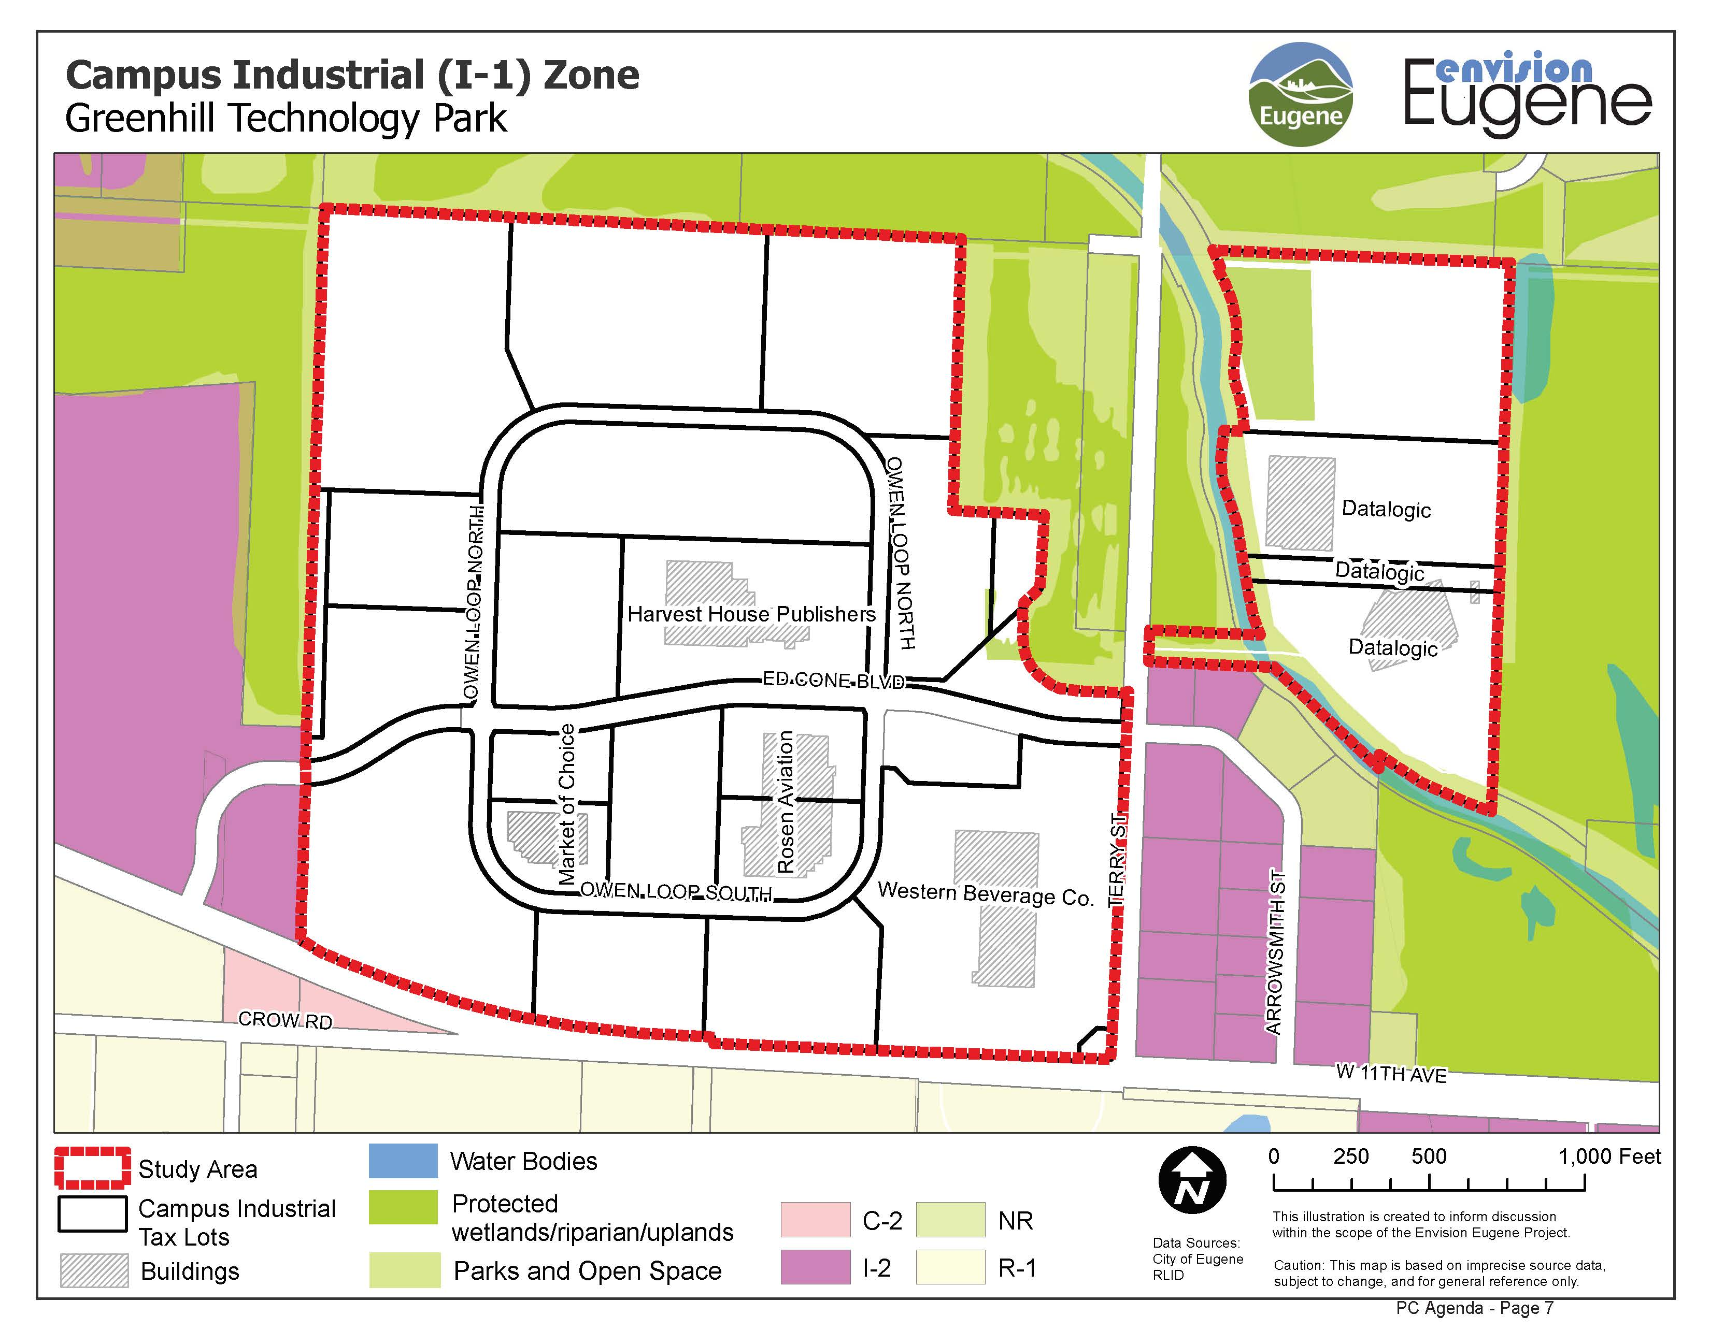
Greenhill – Zoning Map

Slide 15
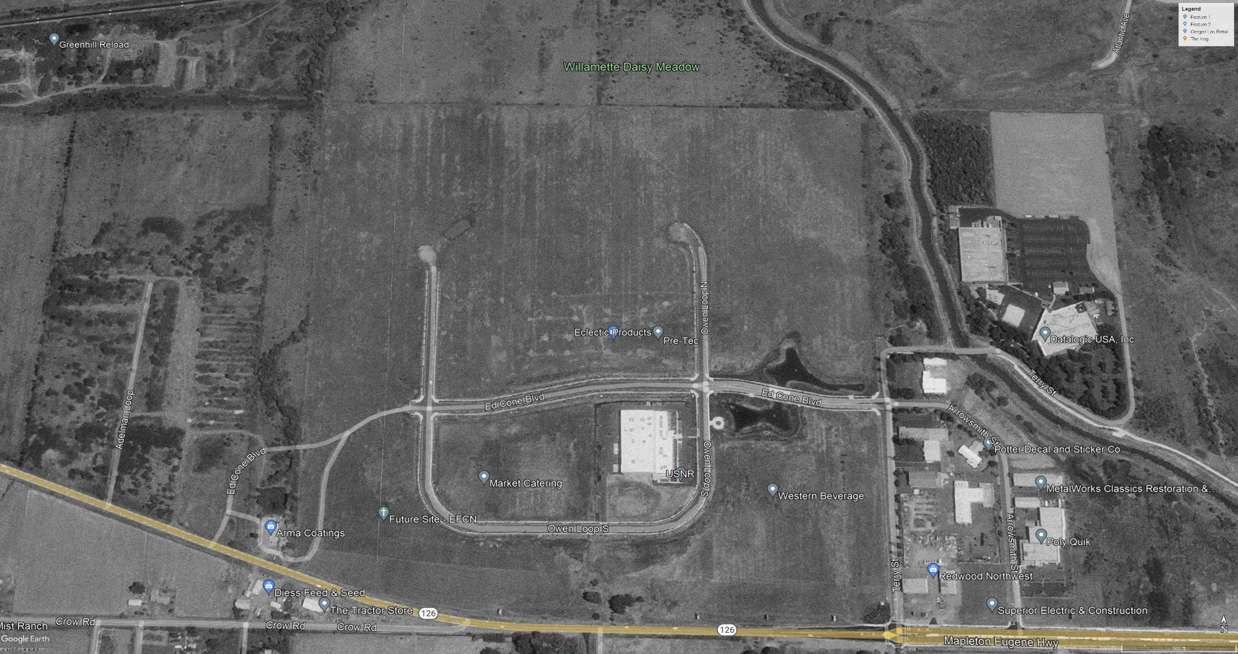
Greenhill - 2000

Slide 16
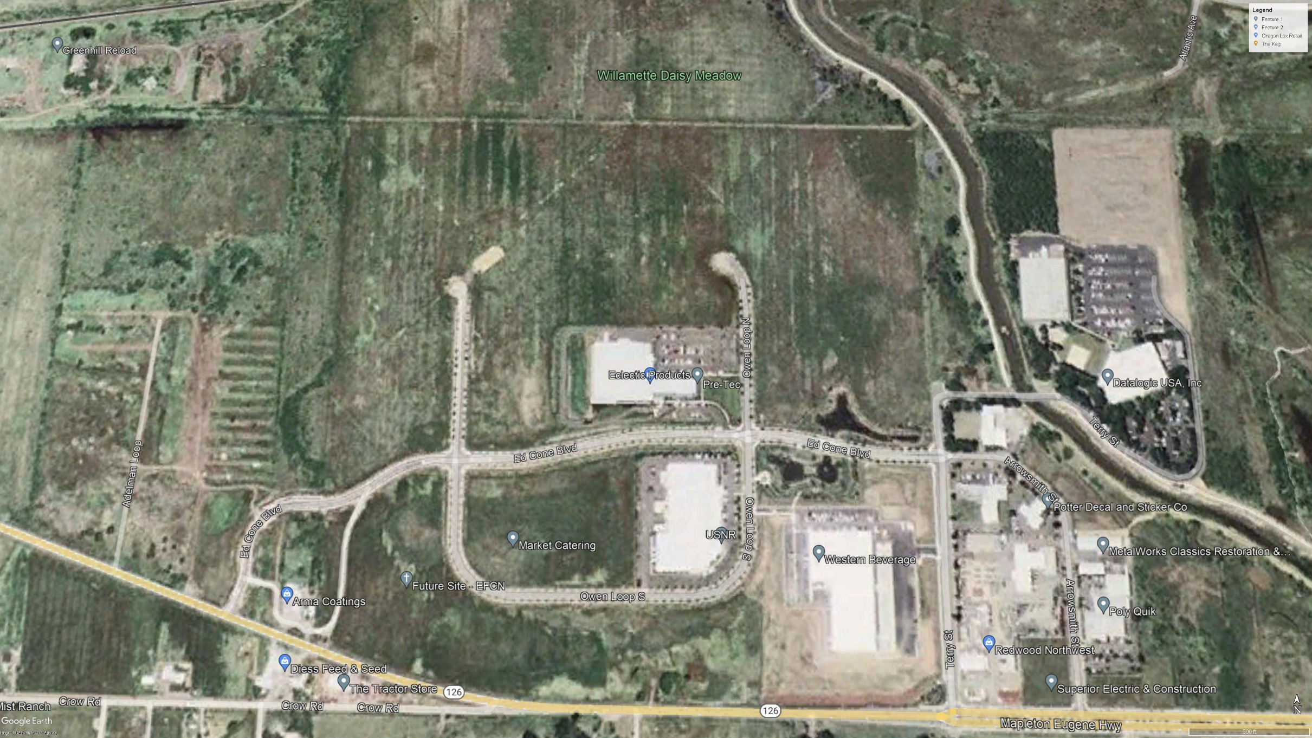
Greenhill - 2006

Slide 17
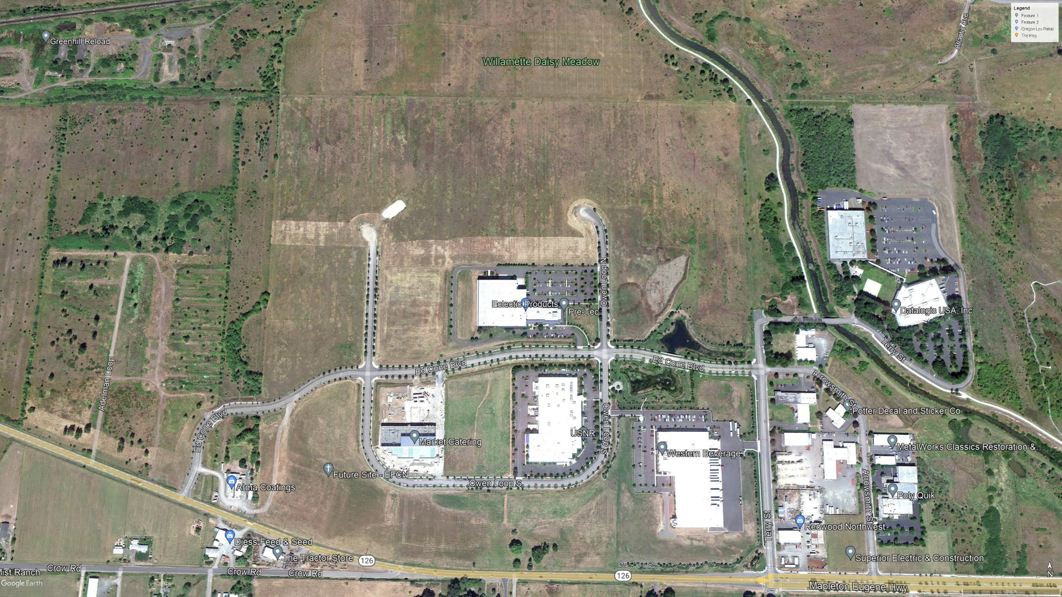
Greenhill 2011

Slide 18
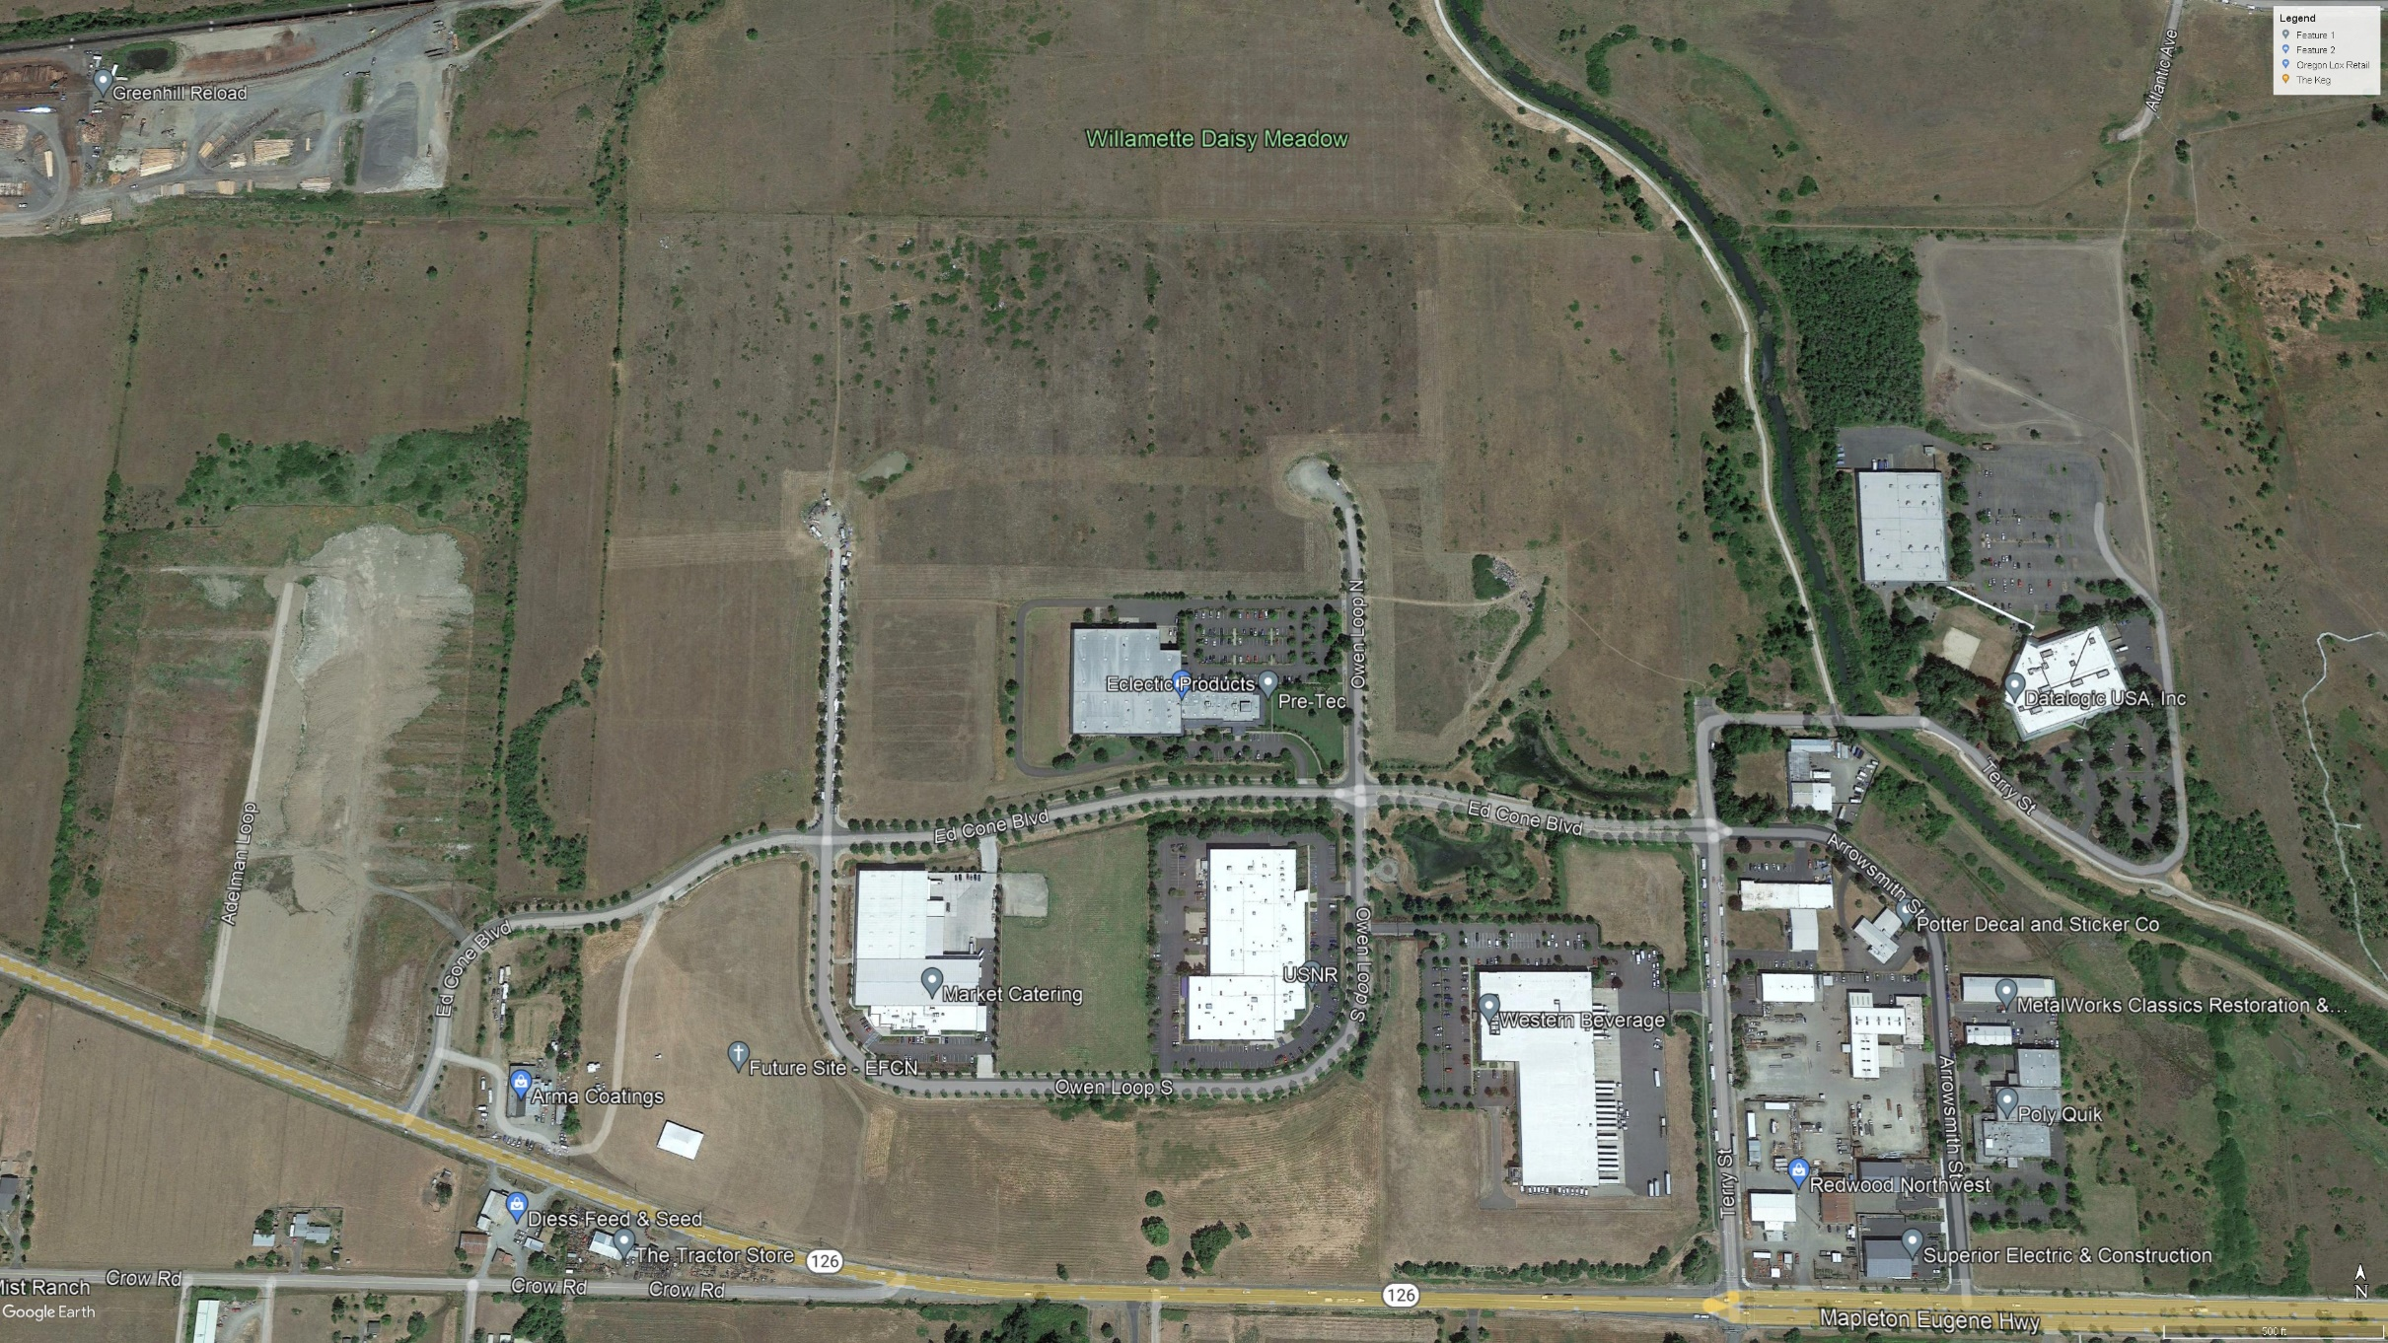
Greenhill - 2021

Slide 19
Greenhill – Takeaways
Very expensive buildout
Not done in stages
Properties purchased with no development
Open space was 20%, not Coburg’s 40%
No new development since Anheuser Busch
Developer went bankrupt
Demonstrates the risk associated with any development
Was Eugene’s promoted success story in 2000
Strict use requirements made it undesirable and uneconomical to develop

Slide 20
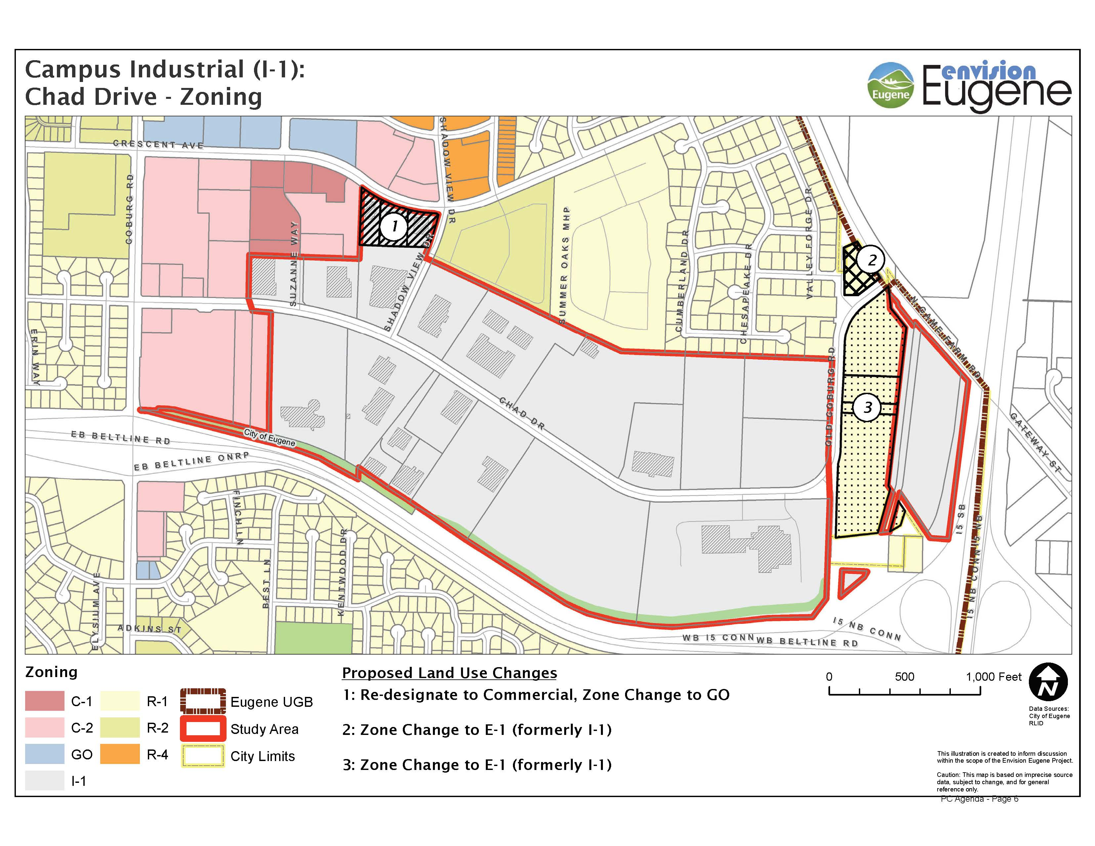
Chad Drive Zoning Map

Slide 21
Chad Drive - 2000

Slide 22
Chad Drive - 2021

Slide 23
Gateway - 1993

Slide 24
Gateway - 2003

Slide 25
Gateway - 2011

Slide 26
Gateway - 2014

Slide 27
Gateway - 2021

Slide 28
Gateway - Takeaways
First subdivided almost 30 years ago
Still only 50% developed
More available uses than Coburg Campus Industrial zone allows
Sony and Symantec were early developments
When they left, vacancies have been hard to fill, many jobs lost
Hawes Building developed in 2007
Good picture of current state of office space
COVID has driven down tenancies and office space values
Restaurant, coffee shop closed
Approx. 70% vacant

Slide 29
Gateway – Takeaways, Cont.
No Development since 2014
CI early successes in Gateway show businesses suited to CI
Office buildings
Small lots
Inside urban areas

Slide 30
Campus Industrial History - Summary
Very limited success over the last 20 years in three different areas
Greenhill ended in bankruptcy
Chad Drive – One development in 20 years
Gateway
Smaller parcels and more uses led to early success
Office space in that area no longer in demand
In current environment and with zoning restrictions, CI would also fail with this development

Slide 31
John Brown
Real Estate Broker

Slide 32
Master Plan Overview - Developer
Councilor Alexander asked how City can rely on us to bring forward good end users
Good working relationship with City
Can’t move forward without City’s approval of Master Plan
Developer needs to bring end users that fit

Slide 33
Master Plan Process, Contd.
Developer and End User present Master Plan
Two types of revisions
No cost changes
Different lighting choices
Movement of features
Corrections
Preferences of City that can be implemented with no additional cost
Negotiations
End user wants a bigger building, City wants more outdoor areas for employees

Slide 34
Master Plan Process, Contd.
Bottom Line – Developer, End User and City all have to agree before we can move forward
Collaborative process
Example – Buffer area

Slide 35
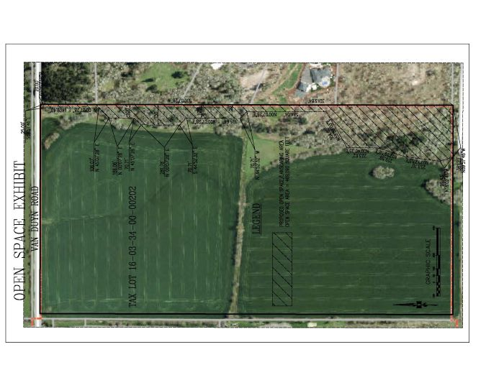
Master Plan Process, Contd.

Slide 36
Financial Impact of Campus Industrial
Development – Almost all costs are up front
Before Construction
Legal Expenses
Planners
Traffic Experts and Studies
Wetlands Experts
Permits and Fees

Slide 37
Financial Impact of Campus Industrial , Contd.
Development – Almost all costs are up front
Once Approved
Wetland Mitigation
Road Construction
Right of Way
Excavation
Rocking
Asphalt
Sidewalks
Lighting
Sewer, Water and Power Lines
Millions of dollars spent before the first sale can be made

Slide 38
Financial Impact of Campus Industrial , Contd.
With Campus Industrial zoning
Not viable to move forward on a project that would fail
With Light Industrial zoning
Would move forward breaking ground when wetland fill permit is issued

Slide 39
Summary
This is a long process
Started on 2010 and have methodically worked our way here
Show the differences between Light Industrial and Campus Industrial
Differences in allowed uses
Difference in demand
Bigfoot is a real world example of that difference
Campus Industrial History
Greenhill – Ended in bankruptcy
Chad Drive – Only one development in 22 years
Gateway – Early successes but shift to office space has led to stagnation

Slide 40
Summary
Master Plan Process
City, Developer and End User are collaborators, unable to move forward unless all agree
Finally, if Campus Industrial is chosen, we don’t see a path forward to develop a large property with no demand or isn’t economically feasible
Thank you for your time
Any questions?

